Slide 1
WebSolutions: 新計劃、新機會
WebSolutions: New Programs, New Opportunities
Frances Siu
專業經理級
Professional Coordinator
四個佣金週期共賺取HK$34,500
HK$34,500 in 4 Commission weeks
本簡報中提到的收入等級純屬舉例說明，無意代表美安香港超連鎖™店主的一般收入，也無意表示任何超連鎖™店主皆可賺取同等收入。美安香港超連鎖™店主的成功與否，取決於其在發展事業時的努力、才能與投入程度。
The income levels mentioned in the following presentation are for illustration purposes only. They are not intended to represent the income of a typical Market Hong Kong UnFranchise ™Owner, nor are they intended to represent that any given Independent UnFranchise ™ Owner will earn income in that amount. The success of any Market Hong Kong Independent UnFranchise ™ Owner will depend upon the amount of hard work, talent, and dedication which he or she devotes to building his or her Market Hong Kong Business.

Slide 2
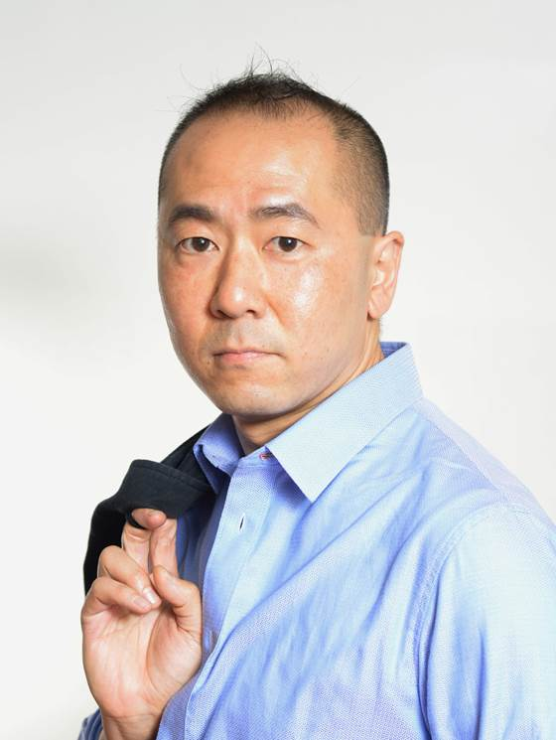
WebSolutions: 新計劃、新機會
WebSolutions: New Programs, New Opportunities
Matthew Lai
主管經理級
Master Coordinator
四個佣金週期共賺取HK$16,100
HK$16,100 in 4 Commission weeks
本簡報中提到的收入等級純屬舉例說明，無意代表美安香港超連鎖™店主的一般收入，也無意表示任何超連鎖™店主皆可賺取同等收入。美安香港超連鎖™店主的成功與否，取決於其在發展事業時的努力、才能與投入程度。
The income levels mentioned in the following presentation are for illustration purposes only. They are not intended to represent the income of a typical Market Hong Kong UnFranchise ™Owner, nor are they intended to represent that any given Independent UnFranchise ™ Owner will earn income in that amount. The success of any Market Hong Kong Independent UnFranchise ™ Owner will depend upon the amount of hard work, talent, and dedication which he or she devotes to building his or her Market Hong Kong Business.

Slide 3
[
]
WebSolutions:
New Programs, New Opportunities

Slide 4
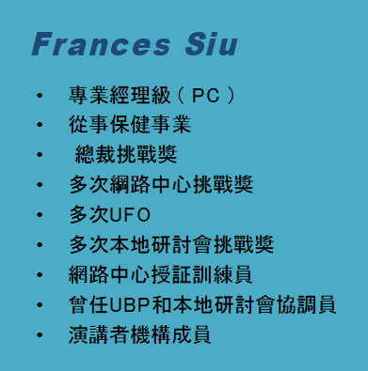
Matthew Lai
Master Coordinator(MC)
Full-time I.T. Project Manager
20 years of experience in the I.T. industry
MUFO qualifier
Local Seminar Challenger Winner
WebCenter Certified Trainer
Member of Speaker Bureau
Professional Coordinator (PC)
President (Chairman) Challenge Winner
WebCenter Challenge Winner
MUFO qualifier
Local Seminar Challenge Winner
WebCenter Certified Trainer
Member of Speaker Bureau

Slide 5
The average person spends 5.2 hours per day on their mobile device
74% of people are more likely to visit mobile-optimized sites
INTERNET CLIMATE
85% of customers expect businesses to be active on social media
There are 3.4 billion Google searches per day. 61% are for local searches
88% of consumers read online reviews to determine the quality of a local business
Notes:
TRAINER’S NOTES:
Here are some talking points:
We are all consumers of websites in our every day lives. Think about where you read your news, socialize etc.
Would you agree that people are plugged in and get much of their information online?
Businesses need to be online so they can interact with their customers and potential customers
Customers have an expectation to be able to browse websites for products, information and services

Slide 6
A PROVEN, DUPLICATABLE, SYSTEM TO PROVIDE
SMALL BUSINESS OWNERS AN EFFECTIVE INTERNET PRESENCE
TOGETHER, WE HELP BUSINESSES AND ORGANIZATIONS WITH:
Increasing Revenues
STREAMLINING BUSINESS PRACTICES
Decreasing Expenses
INCREASING ENGAGEMENT
Increasing Customer Satisfaction
MARKETING THEIR BUSINESS
Notes:
講師筆記：
再次重申，請使用可以更清楚說明您的夥伴關係的文字，所以請說「我們」而不是「我」

Slide 7
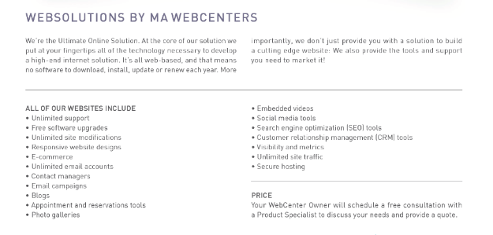
MORE THAN JUST A WEBSITE
Notes:
Trainers Notes:
This is just an intro slide – The goal here is to get them excited about what we are going to talk about.
In brief, cover the big topics “Websites, Marketing Tools, Unlimited, Support, Security)
The goal is to paint a simple picture of how all –inclusive our solution actually is / Instill confidence in the product.
Spend 1 minute or less on this slide – the details are coming up!

Slide 8
[
]
B2B SOLUTIONS
MARKETING & THE SHOPPING ANNUITY

Slide 9
社群媒體
Social Media
Social media management, network reputation management, advanced Facebook ads
Digital Marketing
Local search engine optimization, regional search engine optimization, GOOGLE advertising, content writing, Wordpress.org
Website Management
Monthly management package for basic members
Monthly maintenance and management package for regular members
Monthly maintenance and management package for administrator
Notes:
講師筆記：
展示客戶可以透過美安網路中心購買的所有服務
最大的區別是他們要自己做，還是借力我們的專家團隊為他們做。

Slide 10
CASE STUDY: BEFORE
WINGS OVER WATER
CASE STUDY: AFTER WINGS OVER WATER
BEFORE
With 2 locations, they were spending too much time emailing information to their customers.
Customers can now:
Book birthday parties online
Get directions
Register Online
Download parent guide
Navigate classes and identify what class is appropriate for your child.
Notes:
Trainers Notes:
Before and After
Having a better online presence can result in more sales because of the convenience of online registration, class selection and research
It also saves time when your website is built to answer most questions and allow consumers to conduct research

Slide 11
THE FIVE Cs
The most successful WCOs do the following 5 steps for quality appointments and clients
CANDIDATES: Identify Leads
CURRENT: Candidate Research
CONTACT: Contact Candidates
CONSULT: Conduct a 15 min. Consult
CLOSE: Product Specialist Closes Your Client

Slide 12
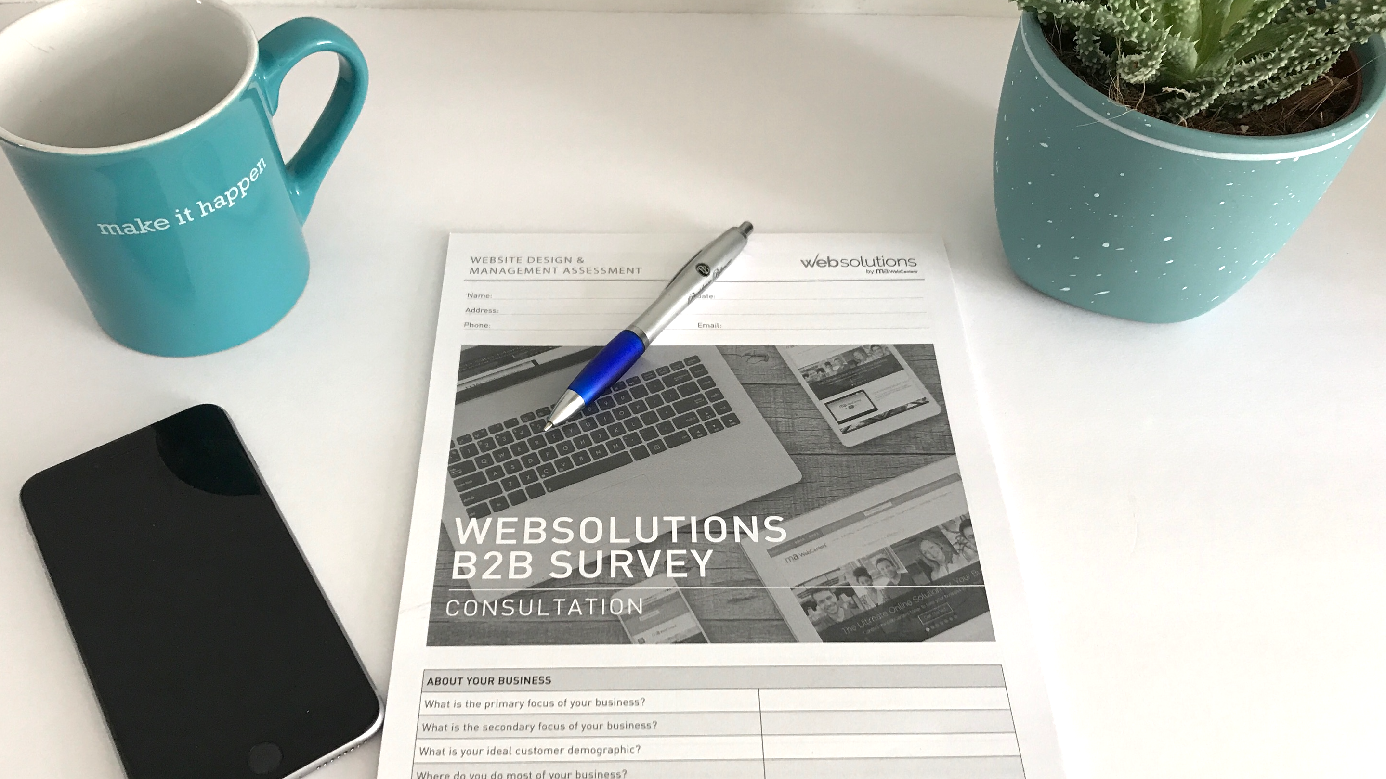
Start your own business
But you are
not alone

Slide 13
IMPORTANT ITEMS TO DOWNLOAD AND/OR PURCHASE
15 MINUTE CONSULTATIONS UNFRANCHISE ORDER: T660B2B: All 3 Pads T663B2B: Website Design T662B2B: Digital & Social Media T664B2B: Business Spending Download: www.mawc411.com
B2B SERVICES CATALOG UNFRANCHISE ORDER: T661B2B: Pack of 5 Download: www.mawc411.com
Notes:
Sarah

Slide 14
Candidates Before YOU CAN CONTACT ANYONE, YOU HAVE TO GENERATE LEADS
POSSIBILITIES ARE EVERYWHERE.
Notes:
TRAINER’S NOTES:
STEP 1 – Generate leads / prospects/ candidates
It’s a critical step that many people rush through or completely skip. If you don’t take the time to generate a healthy list to start with, you can quickly run out of possibilities to work with.

Slide 15
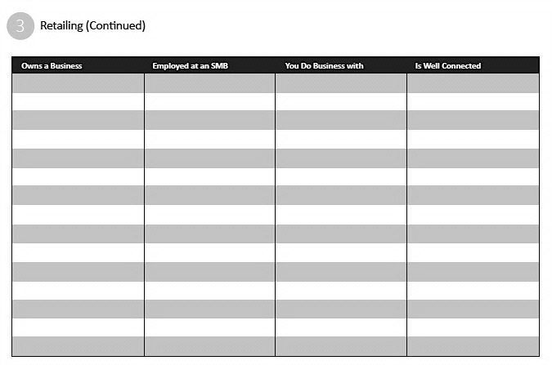
Who Do You Know? One industry at a time, go column by column
Restaurants
Contractors
Lawyers
Gyms
Salons
Car Detailers
Dentists
Doctors
Landscapers
Retail Shops
Organizations
Churches
Other

Slide 16
CURRENT GOOGLE THEM TO FIND OUT A LITTLE MORE ABOUT THEIR CURRENT ONLINE SITUATION MOTIVATES YOU TO CONTACT THEM & PREPARES YOU WITH GREAT QUESTIONS TO ASK
Notes:
TRAINER’S NOTES:
STEP 1 – Generate leads / prospects/ candidates
It’s a critical step that many people rush through or completely skip. If you don’t take the time to generate a healthy list to start with, you can quickly run out of possibilities to work with.

Slide 17
WHAT SHOULD YOU LOOK FOR WHEN RESEARCHING YOUR CANDIDATES?
PROSPECT RESEARCH SHOULD ONLY TAKE ABOUT 1 MINUTE
EX: GOOGLE YOUR FAVORITE RESTAURANT AND NOTE:
Do they show up on Google?
Do they have a current / up to date site?
Is it responsive?
Are they using Social media?
Is their competition showing up on Google?
Notes:
TRAINER’S NOTES:
In some areas you see yourself as being very confident. Think of the things that you say to yourself, oh, you know I do such and such really well. If someone asked you about that subject you would talk confidently on the topic you would feel strong and confident about answering any questions that they have about the subject, and if you needed to, you would have no problem winning someone over on that subject or topic.
What about the areas that you think you are “bad” at. Many people say they are “bad” at remembering people’s names. Well, in a lot of cases, that’s just an excuse for them to not remember people’s names. Try saying to yourself for two weeks “I’m great at remembering people’s names” Every time you start to think to yourself that you are “bad at remembering names” just cancel that message and say to yourself, “you know, I’m actually really good at remembering people’s names” I’ll guarantee that if you do this consistently for two weeks, you’ll notice just how good you are at remembering names.
This isn’t an issue of whether you actually are good or bad at remembering names, what it really is an issue of, is what you “program” yourself to be.
Stop programming yourself the wrong way and telling yourself that you are “bad” at this or that, program yourself to be “good” at these things and you will start to see improvement.

Slide 18
CONTACT WITH A LITTLE INFO IN YOUR BACKPOCKet AS A CONVERSATION STARTER, IT’S TIME TO CONTACT YOUR CANDIDATES. SO WHAT DOES THIS LOOK LIKE?
Notes:
TRAINER’S NOTES:
STEP 1 – Generate leads / prospects/ candidates
It’s a critical step that many people rush through or completely skip. If you don’t take the time to generate a healthy list to start with, you can quickly run out of possibilities to work with.

Slide 19
DECIDE HOW YOU WILL CONTACT THEM
The best form of communication is your candidate’s preferred method / most reachable form: Phone Call, Text, Social Media
PURPOSE & GOAL OF THE CONTACT:
START A CONVERSATION & IDENTIFY:
Is there a need?
Could we potentially help them with that need?
Would they be willing to do a 15-minute consultation?
Notes:
TRAINER’S NOTES:
If they understand the purpose of the call/contact, they can be focused on the best end result – a 15 minute consul scheduled based on a solid need that was identified during the conversation
It’s not always a phone call that is best – though a lot of times it is. Social media messaging and texts can be just as effective to communicate if that seems to be the best way to reach someone

Slide 20
CONSULT BOOK & CONDUCT A 15 MINUTE CONSULTATION
WEBSITE DESIGN & MANAGEMENT, DIGITAL & SOCIAL MEDIA MARKETING
Notes:
TRAINER’S NOTES:
Once you’ve identified a few areas where it could be a good fit, the next thing is to book and conduct a 15 minute consultation
These sheets can be found on www.mawc411.com and purchased in pads of 50 on UnFranchise (USA only)

Slide 21
CLOSE SCHEDULE AN APPOINTMENT WITH THE PRODUCT SPECIALIST
THEY WILL CLOSE THE APPOINTMENT FOR YOU
Notes:
TRAINER’S NOTES:
You’ve now identified a candidate, researched them, talked to them and done a 15 minute consult. By the time

Slide 22
CASE STUDY: AFTER
hair rejuvenation
Website Sales＄20000
Retail Profit ＄12123
Website Sales 200 BV
Repeating Sales 30 BV

Slide 23
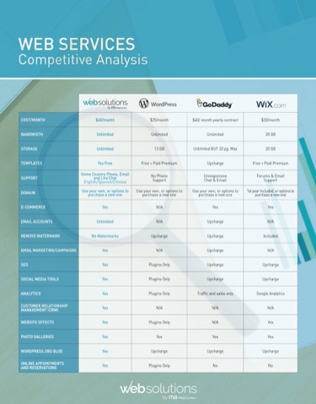
NEW RESOURCES
COMING SOON!
MARKETING MANUAL
Statistics & Definitions
Industry Specific Recommendations
WebCenter & WebCenter Pro
Download: www.mawc411.com
COMPARISON CHART Competitive Analysis
Download: www.mawc411.com
WELCOME GUIDE Coming soon!
Download: www.mawc411.com
Notes:
Jason

Slide 24
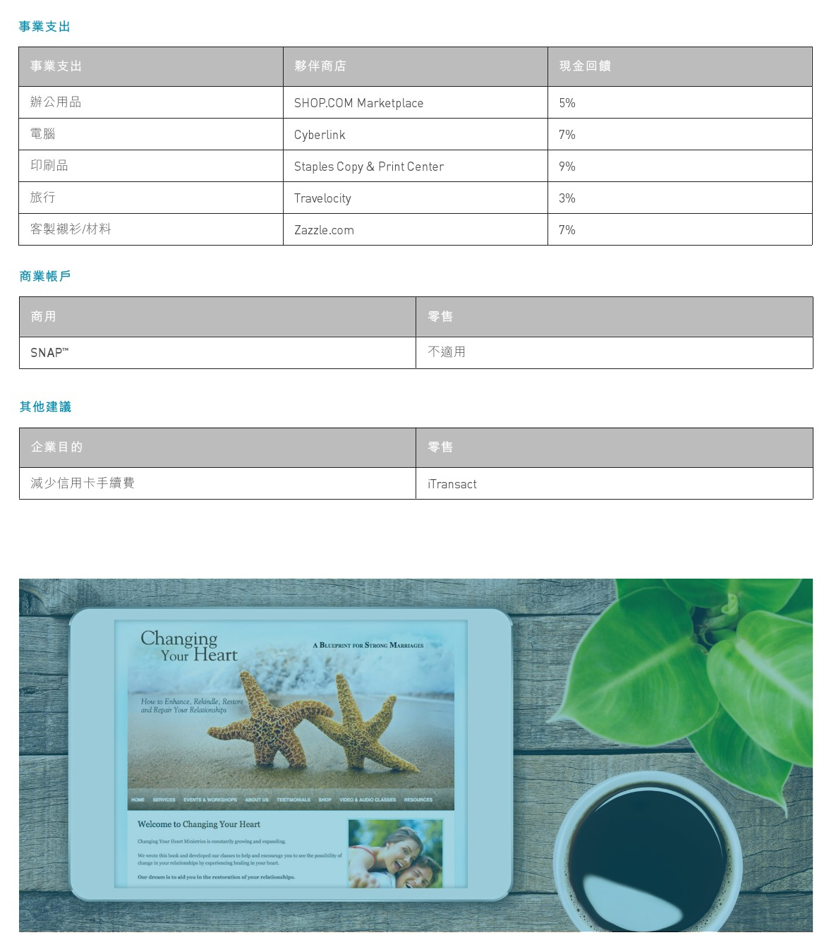
B2B
SPENDING ASSESSMENT
RECOMMENDATIONS
Notes:
SR

Slide 25
Network solution
For Potential sales target
SPENDING ASSESSMENT
Raise Interest by shopping annuity
UnFRANCHISE OWNERS
UnFRANCHISE OWNERS convert personal and business expenses!
Leverage the power of cooperation with B2B Partners
Notes:
Jason

Slide 26
New webcenter Certified training 101 & 201
Have been posted on GMTSS
Welcome to join us

Slide 27
Ways to become a WebCenter Owner
(1) | (2) | (3)
Purchase a new WebCenter | Fast Start Kit | Get your 3 tickets to Annual Convention 2018
HK$2730 | HK$3237 (Only for new UFOs who haven’t purchased any fast start kit before) | Free
Monthly fee HK$351

Slide 28
Nov-Dec,2017 WebCenter Training
GMTSS Training | Date | Time | Venue
WebCenter Training 101 | 11/11/2017 (Sat) | 14:00 | Sham Shui Po
WebCenter UMO | 11/13/2017 (Mon) | 18:00 | Tsim Sha Tsui
WebCenter Training 101 | 11/19/2017 (Sun) | 14:00 | Tsim Sha Tsui
WebCenter Training 201 | 11/25/2017 (Sat) | 14:00 | Tsim Sha Tsui
WebCenter UMO | 12/01/2017 (Fri) | 18:00 | Tsim Sha Tsui
WebCenter Training 101 | 12/03/2017 (Sun) | 14:00 | Tsim Sha Tsui
WebCenter Training 201 | 12/17/2017 (Sun) | 14:00 | Tsim Sha Tsui

Slide 29
Nov-Dec,2017 WebCenter Training
GMTSS Training | Date | Time | Venue | Speakers
WebCenter Training 101 | 11/11/2017 (Sat) | 14:00 | Sham Shui Po | Maggie& Carol&Joyee
WebCenter UMO | 11/13/2017 (Mon) | 18:00 | Tsim Sha Tsui | Matthew
WebCenter Training 101 | 11/19/2017 (Sun) | 14:00 | Tsim Sha Tsui | Matthew
WebCenter Training 201 | 11/25/2017 (Sat) | 14:00 | Tsim Sha Tsui | Kirk & Frances
WebCenter UMO | 12/01/2017 (Fri) | 18:00 | Tsim Sha Tsui | Frances & Winnie
WebCenter Training 101 | 12/03/2017 (Sun) | 14:00 | Tsim Sha Tsui | Matthew
WebCenter Training 201 | 12/17/2017 (Sun) | 14:00 | Tsim Sha Tsui | Maggie

Slide 30
YOU NEED A WEBCENTER
FREE WEBCENTER SPECIAL!
VISIT THE BOOTH & RETURN YOUR FORM!
Buy WCT101 & 201 tickets
Know more about the latest information of WebCenter
Enquire about what is in WebCenter
Learn how to run a WebCenter business with Trainers
Notes:
(I minute )

